Slide 1
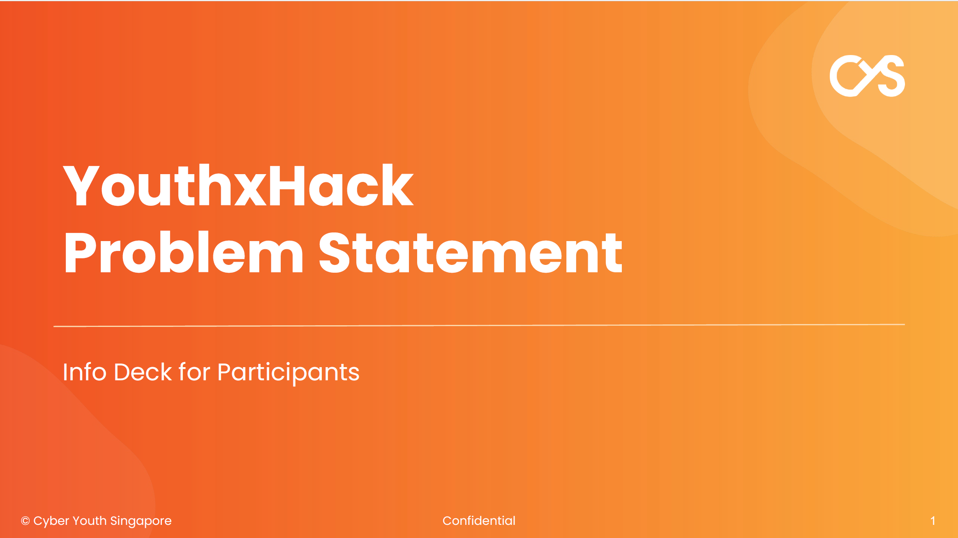

Slide 2
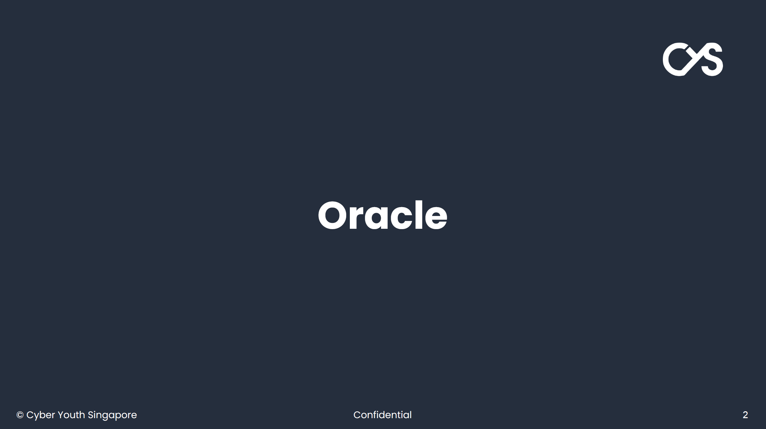


Slide 3
Title
A Holistic Solution for Food Insecurity

Slide 4
Overview
Food insecurity is an ongoing concern particularly for the vulnerable communities such as the elderly and those with limited resources. In times of crisis, food insecurity problem can be greatly magnified, and a greater segment of the population can be affected. So, it is a problem that societies would have to deal with whether in peace time or in time of a crisis.
For an affluent society like Singapore, food wastage is also an ongoing concern. According to the NEA, The total amount of food waste generated in 2023 was 755,000 tonnes. The recycling rate for food waste was 18 per cent.
In a lot of cases, unconsumed food go straight to the dumpster due to various reasons. There are different sources and types of food with the propensity of wastage. We have the caterers, the restaurants, the hotels etc. And there are the fresh foods as well as foods with longer but about to expire shelf life.
And then, there are volunteers who could distribute food from the food sources to the individuals in need of them.
This challenge invites participants to develop a framework to match food sources to recipients in the most efficient way and involve the various groups of communities and entities mentioned. Participants can choose to focus on technology, or innovative strategies, or a combination of them that could help improve efficiency and reduce wastage of food.
The solution should go beyond the low hanging fruit of large supply/demand groups (e.g. delivering the surplus of a wedding banquet to a home for the disabled). Instead, the team should use the power of data to solve this problem at scale for individuals (e.g. picking up 54 leftover meals from various hawker centre stalls and distributing them to various needy families).

Slide 5
Problem Statement
How can we address food insecurity problem in a holistic and efficient way, involving technology and innovative strategies?
This will be a major problem in times of crisis, that we can develop solutions and optimise for in peacetime.

Slide 6
Objectives
Develop a framework to capture the following data
communities in need of food, or areas with high food insecurity
sources and types of food that could be donated
logistics to bring the food from the sources to the target communities
Supply Chain strategies involving innovative ideas like the following:
algorithm or method to optimize the delivery of food to the individuals in greatest need, and in the quickest time, with minimal carbon footprint
enhance community engagement in the distribution of food
efficient ways to link the recipients, the donors, the delivery agents

Slide 7
Constraints & Requirements
Considerations involving
dietary restrictions (e.g., religion, food allergies of recipients)
types and attributes of the food (e.g., fresh food that need to be consumed in next 2 hours)
safety protocol to meet health and safety standards
attributes concerning the delivery agents
link up with various sources of food like the Food Bank Singapore, Food from the Heart, apart from restaurants and hotels to provide a holistic platform to enhance food distribution and minimize wastage
Present an architecture of how this framework would function
show the user interface/s (can be a mockup) with the input fields
show how the various solution components communicate with each other
describe how technologies like data, AI (e.g. specific algorithms or services) can be used to enable the solution

Slide 8
Target Audience
The solution is intended to benefit Singapore's vulnerable populations, including the elderly, low-income families, as well as people facing food insecurity in times of crisis.
A list of the stakeholders could be:
Individuals or segment of population facing food insecurity
Social Welfare organizations
Volunteers
F&B or hospitality related enterprises
Food banks, etc.

Slide 9
Success Criteria
Food Access: holistic access to food for vulnerable individuals or segment of population
Supply Chain Efficiency: Improved management of food supplies, with reduced waste and timely distribution.
Community Impact: Strong engagement from enterprises, volunteers, and community organizations in supporting the food distribution network.
Scaleaable: Solution should be highly scaleable to automate the addition of new food suppliers, needy recipients or volunteers

Slide 10
Resource & Tools
Present any resources, methods, algorithms, database platforms, user interface or other tools that will be provided or recommended to participants.
Participants will have access to the OCI platform to create a screen mockup, or partially/fully working solution.
Proposals that are judged to be promising will be given additional resources to implement actual working prototypes and a chance to make a real difference to solve this problem.

Slide 11
Bonus Challenge
Develop a dashboard that analyses:
The food sources and food put up for donation, by type, quantity, time period, etc.
The beneficiaries of the program, what they receive, when etc.
The help from volunteers in terms of who they are, the time, the delivery etc.
A leaderboard to rank the top contributors and volunteers
Some measures of efficiencies (by day, week, month), e.g.:
track wastage
track the proportion of requests achieved
track the issues encountered, and
classify them
enable updates from stakeholders

